Slide 1

Security Analysis of the
Internet Architecture
Master Thesis - Marco Seewer
Supervised by Roland Meier, Jordi Nieto, and Adrian Perrig
This research is supported by armasuisse Science and Technology.

Slide 2


SWITCH
AS: 559
CYD Testbed:
3 ASes
3 Core Ases
  SCION Production Network
Anapaya Routers
  Different HW / SW
  Configurations
Swisscom
AS: 3303
Sunrise
AS: 6730
Zurich AS:
2:0:2b
Thun AS:
2:0:2c
Lausanne AS:
2:0:2d
Notes:
Anapaya SW:
- own BR + Gateway

Slide 3
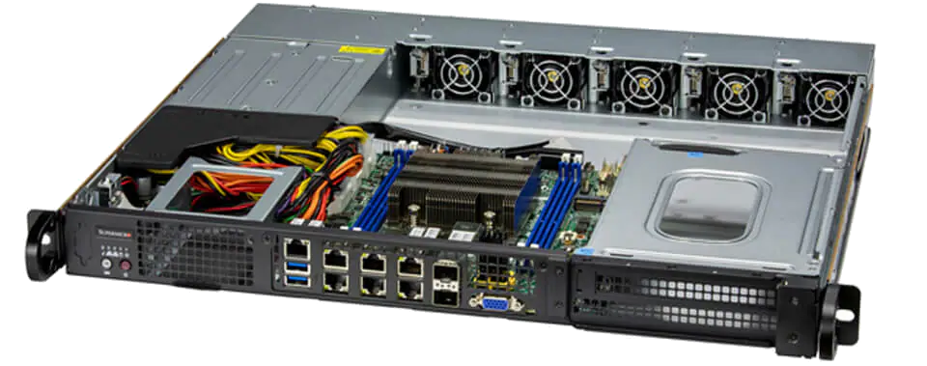
Anapaya Device – Router
Automated scans
  Unauthenticated + authenticated vulnerability scans
  Compliance scans
  Docker images
Manual investigation
  Scan results applicable
  Open ports + running services
  Rev. engineering SCION binary
  SCION configuration (Appliance)
https://www.supermicro.com/files_SYS/images/System/SYS-110D-8C-FRAN8TP_main.jpg
Notes:
Operational devices

Slide 4
Anapaya Device – Router – Results
Scans: Many false positives
(Attacker model: Outside attacker, no local access)
Compliance scans (Passwordless sudo, no password policy, no login timelimit)
Docker images (contains vulnerable openssl version, docker base image contains vulnerable libraries)
https://www.supermicro.com/files_SYS/images/System/SYS-110D-8C-FRAN8TP_main.jpg
Notes:
Operational devices

Slide 5
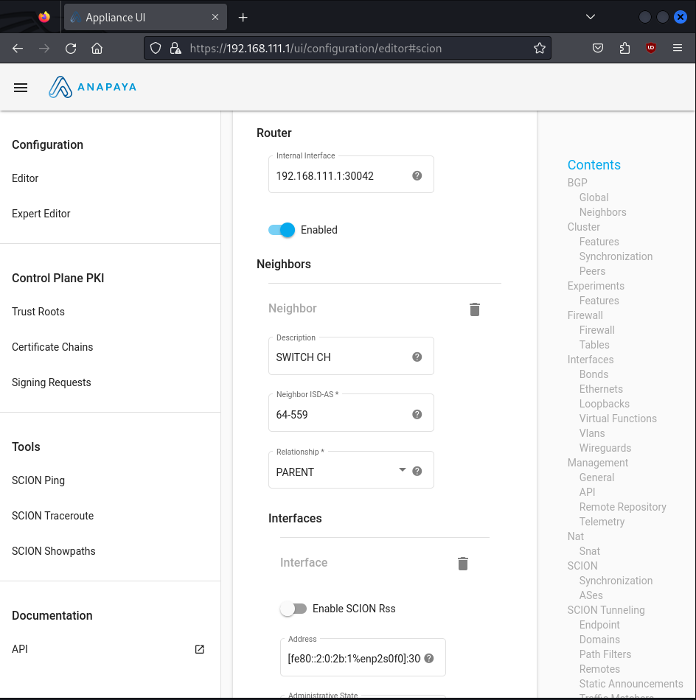
No authentication!
Every CYD SCION user can:
- change config
- upload/install/delete any packages (binaries)
- add new TRC
Notes:
raus

Slide 6
SCION Protocol – Hop fields
MAC in Hop fields
Extracted BR secret + derive MAC value
MAC algorithm = open-source = secure
Notes:
CMAC = AES 128 + additional shifts
Check MAC == open source

Slide 7
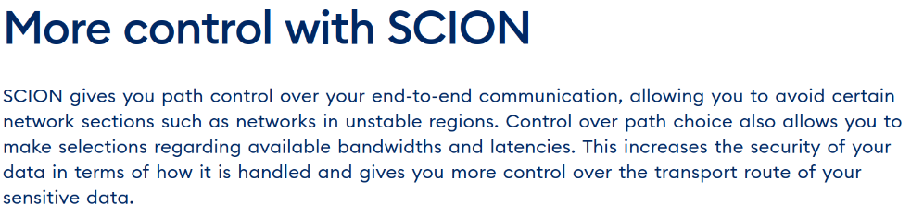
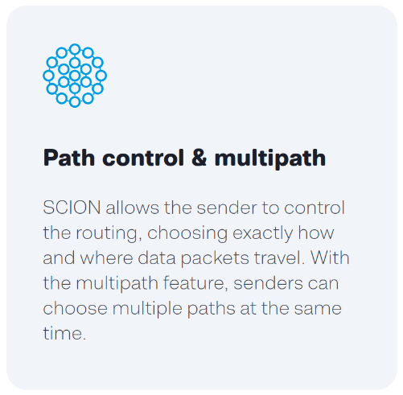
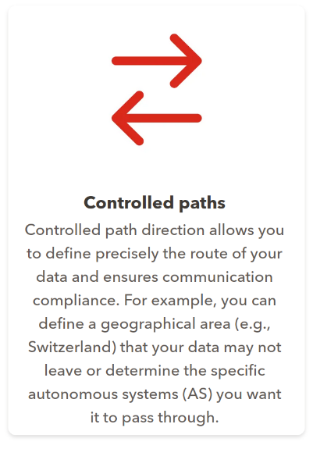
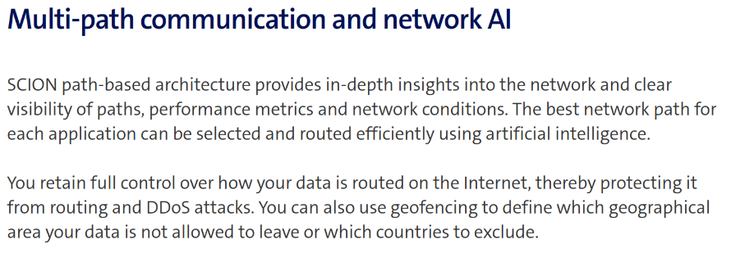
https://www.switch.ch/en/network/scion-access
https://www.anapaya.net/scion-internet
https://www.sunrise.ch/business/en/enterprise/internet-networking/business-wan/scion
https://www.swisscom.ch/en/business/enterprise/offer/wireline/scion.html

Slide 8

AS:12350
SWITCH
AS: 559
AS:15623
Combine hops of different paths
(path splicing)
Swisscom
AS: 3303
Sunrise
AS: 6730
Zurich AS:
2:0:2b
Thun AS:
2:0:2c
Lausanne AS:
2:0:2d
Notes:
Not working → MAC check
Resultat weg

Slide 9




Modify path in header
Revert on response
Works!
SCION
Notes:
Resultat weg

Slide 10
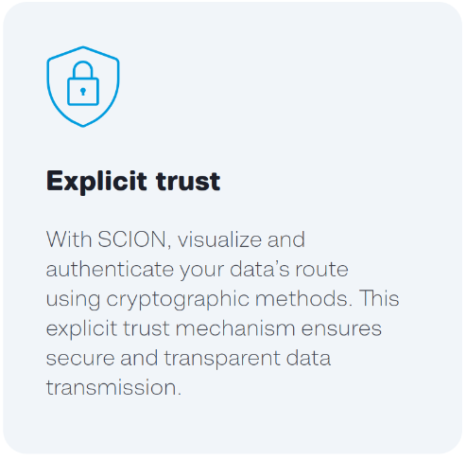

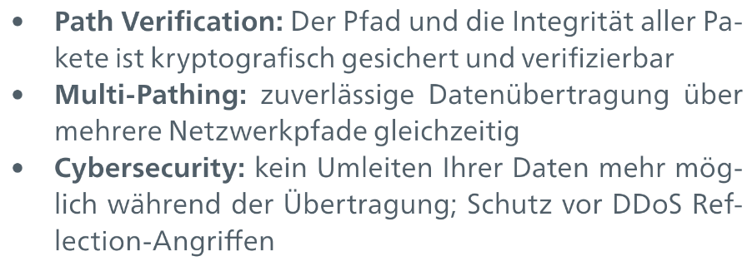
Path manipulation – Preventions
Open source: Packet authentication
Can not be activated/used in Anapaya SCION
No SCION Packet Authentication Option
=
Implement own solution at end hosts
(e.g. authentication, path comparison)
https://www.anapaya.net/scion-internet
https://static.www.switch.ch/sites/default/files/2023-10/switchlan-scion-access-factsheet-de_0.pdf
Notes:
== source authentication

Slide 11
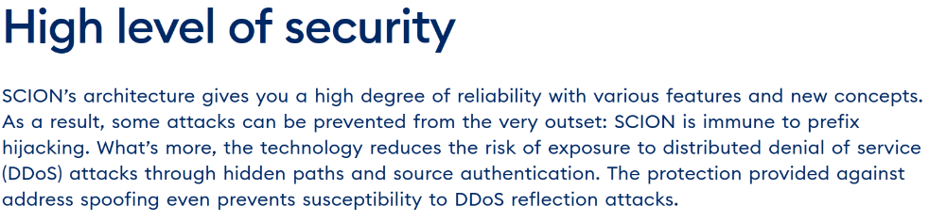
SWITCH
AS: 559
Source Address Spoofing
No AS/Address filtering
If destination performs path-lookup → Works
Forcing path-lookup (with almost expired paths)
→ Not working
Prevention:
Swisscom
AS: 3303
Sunrise
AS: 6730
Zurich AS:
2:0:2b
SRC: 2:0:2c
DST: 2:0:2d
Thun AS:
2:0:2c
SRC: 2:0:2d
DST: 2:0:2c
Lausanne AS:
2:0:2d
https://www.switch.ch/en/network/scion-access
Notes:
Nur test setup keine resultate

Slide 12
Future Plan
Anapaya Device – make use of found weaknesses/vulnerabilities (exploit possible?), Webapp (=Appliance)
Source code SCION binary (Anapaya) OR rev. engineering
Impact of SCION user outside of CYD
Volumetric DoS “normal” Internet → Impact on SCION

